Slide 1
Entering the chart
Hemispheres
Sun, Moon, Ascendant Blends
Idealism
Unaspected Planets

Slide 2
The first impression
of your horoscope suggests…
Basil Fearrington
Kepler webinar 10/11/14

Slide 3
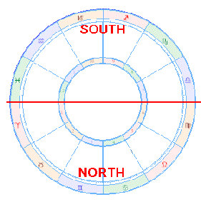
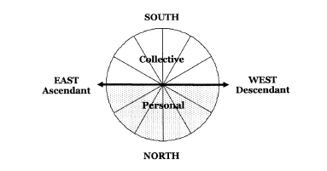

Slide 4
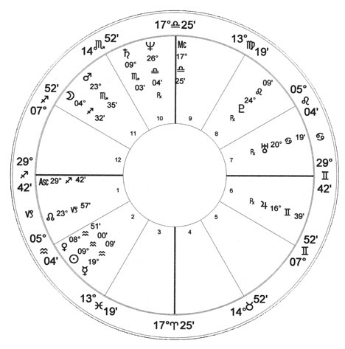
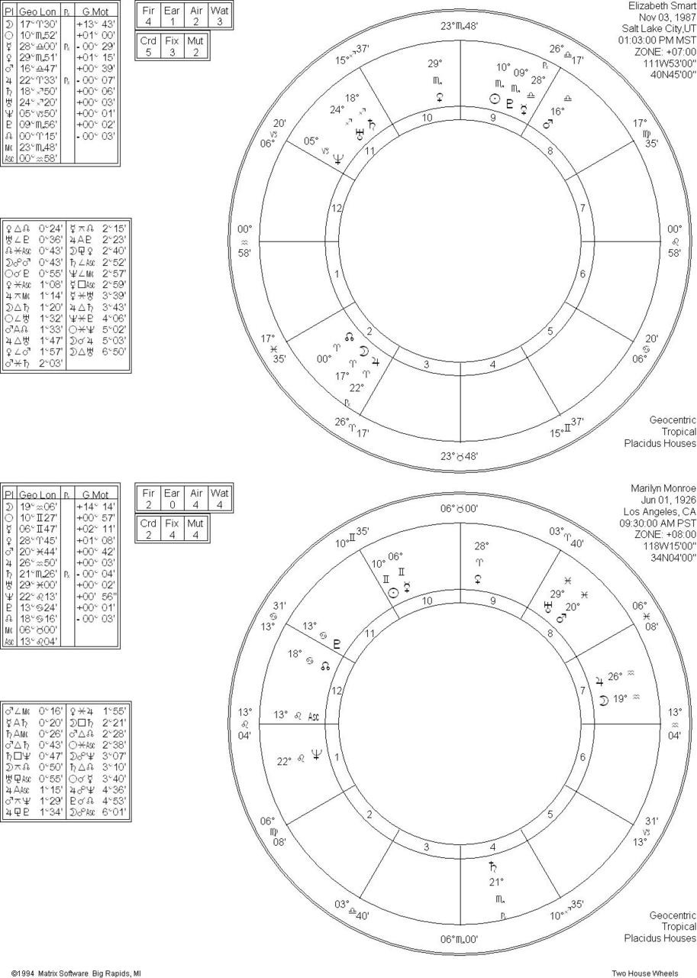
Oprah
Winfrey
The social and other people processes in life. This individual tends to value the opinions of others to the disregard of his own opinions. Strives to balance creativity and reliance through others.
Marilyn
Monroe

Slide 5
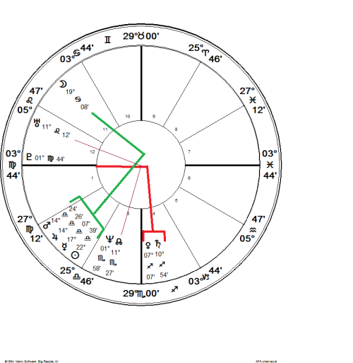
The Me and Self processes in life. Self evolution is the primary goal for this individual with emotional fulfillment from the inside out. Strives to balance creativity with reliance in an self-aware mode.

Slide 6
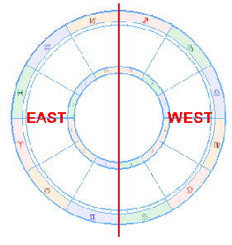
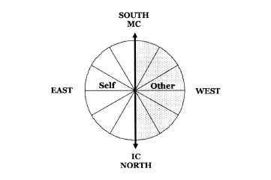

Slide 7
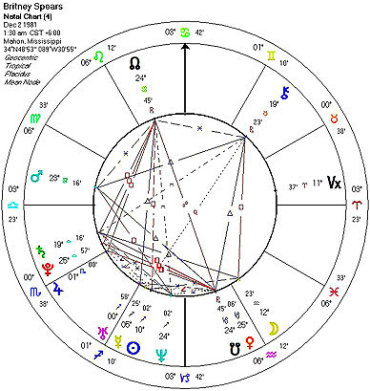
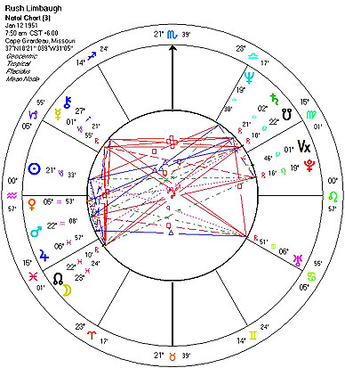
The individual is typically self-reliant and motivated. Considerable drive and force. Just as comfortable working with others as doing a project alone. Strives to balance self with others.

Slide 8
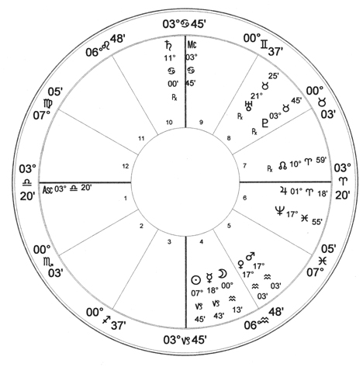
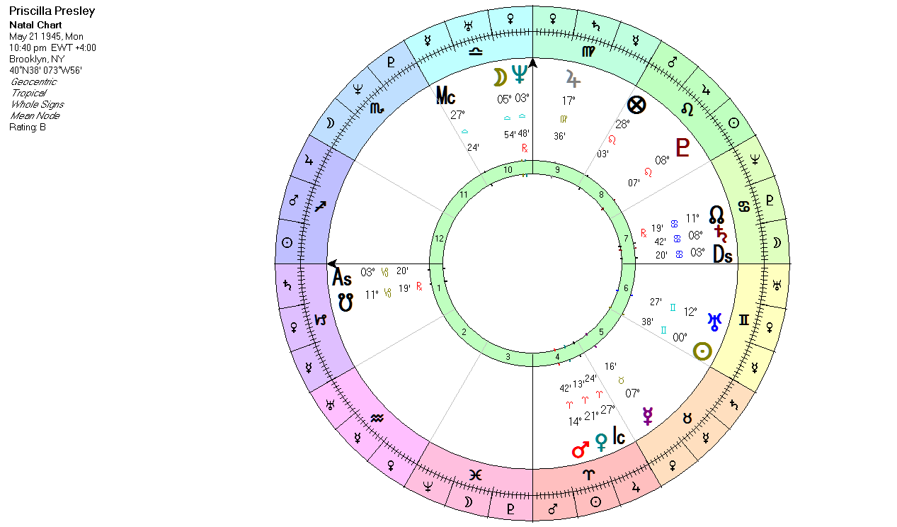
Woodrow
Wilson
Priscilla
Presley
The ultimate team player possibly to the point of losing a sense of self. May lose connections with individuality in efforts to compromise. Tends to need others to motivate him before initiating action. Strives to balance others with self.

Slide 9
Hemisphere | Houses | Traits
North | 1,2,3,4,5,6 | subjective, personalized, self-absorbed
South | 7,8,9,10,11,12 | objective, externalized, group-oriented
East | 10,11,12,1,2,3 | answerable to self, independent
West | 4,5,6,7,8,9 | answerable to others, dependent

Slide 10
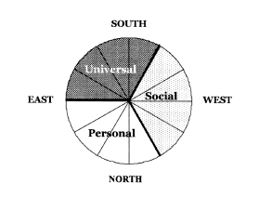

Slide 11
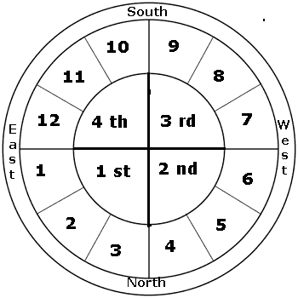
Quadrants

Slide 12
Aries is the first Sign of the zodiac and that tells you just about all that you need to know. The Aries archetype has the air of “do not ignore me” to it Taurus: In Taurus, the idea is to keep things as they are; resist change and keep things secure Gemini needs diversity; to be able to do things quickly; mental stimulation is important. Cancer is completely and totally about the idea of emotional security, even through self-sacrifice. The Leo energy is all about ego security and recognition plus role assumption Virgo has lots of ideas about correctness, how things should be. Discernment, idealism and exactness are present within a keen sense of idealism. Libra: ego fulfillment by being pleasing, fair, and charming though often ambitious Scorpio needs to feel in control of things and it does so by never being in the dark about what is going on. Sagittarius is idealistically opinionated and quite independent. Capricorn is the Manager, the archetype of the responsible person who gets the job done and makes things happen. Aquarius energy is social, humanitarian, or innovative. Pisces is sensitively idealistic, like Cancer, feelings need to be recognized or a martyr complex can develop

Slide 13
Sun in Aries Moon in Aries — The Daredevil Moon in Taurus — The Fortune Hunter Moon in Gemini — The Fast-Talker Moon in Cancer — The Cowardly Lion Moon in Leo — The Dynamo Moon in Virgo — The Faultfinder Moon in Libra — The Rebel Without A Cause Moon in Scorpio — "I'll do it My Way" Moon in Sagittarius — Curiouser and Curiouser Moon in Capricorn — The Status Seeker Moon in Aquarius — The Pioneer Moon in Pisces — The Visionary
Sun in Taurus Moon in Aries — My, Myself and I Moon in Taurus — The Rock of Gibralter Moon in Gemini — The Busybody Moon in Cancer — The Accommodator Moon in Leo — The Entertainer Moon in Virgo — The Voice of Experience Moon in Libra — Mr. Nice Guy Moon in Scorpio — The Pessimist Moon in Sagittarius — The Big Spender Moon in Capricorn — The Worrywart Moon in Aquarius — The Reformer Moon in Pisces — The Shrinking Violet

Slide 14
Sun in Gemini Moon in Aries — The Speed Demon Moon in Taurus — The Troublemaker Moon in Gemini — The Whirling Dervish Moon in Cancer — The Pendulum Moon in Leo — The Ham Moon in Virgo — The Nitpicker Moon in Libra — The Mediator Moon in Scorpio — The Storyteller Moon in Sagittarius — The Soldier of Fortune Moon in Capricorn — The Politician Moon in Aquarius — The Inventor Moon in Pisces — The Split Personality
Sun in Cancer Moon in Aries — The Holier-Than-Thou Moon in Taurus — The Well-stocked Cupboard Moon in Gemini — The Antenna Moon in Cancer — The Protector Moon in Leo — The Defeatist Moon in Virgo — The Servant Moon in Libra — The Organization Man Moon in Scorpio — The Cobra Moon in Sagittarius — The Romantic Moon in Capricorn — The Inferiority Complex Moon in Aquarius — The Zealot Moon in Pisces — The Great Pretender

Slide 15
Sun in Leo Moon in Aries — The Showman Moon in Taurus — The High and Mighty Moon in Gemini — The Con Artist Moon in Cancer — The Stout-hearted Man Moon in Leo — The Peacock Moon in Virgo — The Moralist Moon in Libra — The Crowd Pleaser Moon in Scorpio — The Opportunist Moon in Sagittarius — The Adventurer Moon in Capricorn — The Monarch Moon in Aquarius — The Benefactor Moon in Pisces — The Charmer
Sun in Virgo Moon in Aries — The Clark Kent Moon in Taurus — Old Faithful Moon in Gemini — The Genius Moon in Cancer — The Wallflower Moon in Leo — The Babe in the Woods Moon in Virgo — The Critic Moon in Libra — The Tranquilizer Moon in Scorpio — The Sly Fox Moon in Sagittarius — The cockeyed Optimist Moon in Capricorn — The Self-made Man Moon in Aquarius — The Scientist Moon in Pisces — The Good Samaritan

Slide 16
Sun in Libra Moon in Aries — The Rabble Rouser Moon in Taurus — The Hedonist Moon in Gemini — The Intellectual Moon in Cancer — The Diplomat Moon in Leo — The Personality Kid Moon in Virgo — The Social Worker Moon in Libra — The Social Butterfly Moon in Scorpio — The Wolf in Sheep's Clothing Moon in Sagittarius — The Libertarian Moon in Capricorn — The Social Climber Moon in Aquarius — The Humanitarian Moon in Pisces — The Martyr
Sun in Scorpio Moon in Aries — The Individual Moon in Taurus — The Leader Moon in Gemini — The Salesman Moon in Cancer — The Magnet Moon in Leo — The Magnificent Obesssion Moon in Virgo — The Sleuth Moon in Libra — The Tactician Moon in Scorpio — The Extremist Moon in Sagittarius — The Forerunner Moon in Capricorn — The Power Seeker Moon in Aquarius — The Guru Moon in Pisces — The Sponge

Slide 17
Sun in Sagittarius Moon in Aries — The Tattler Moon in Taurus — The Guilty Conscience Moon in Gemini — The Blithe Spirit Moon in Cancer — The Deep Thinker Moon in Leo — The Show-off Moon in Virgo — The Worldly-wise Moon in Libra — The Scholar Moon in Scorpio — The Crusader Moon in Sagittarius — The Absentminded Professor Moon in Capricorn — The Comic Moon in Aquarius — The Trail Blazer Moon in Pisces — The Poet
Sun in Capricorn Moon in Aries — The Busy Beaver Moon in Taurus — The Solid Citizen Moon in Gemini — The Quick Study Moon in Cancer — The Tough Guy Moon in Leo — The Dictator Moon in Virgo — The Workaholic Moon in Libra — The Socialite Moon in Scorpio — The Fighter Moon in Sagittarius — The Happy-go-lucky person Moon in Capricorn — The Sage Moon in Aquarius — The Prodigy Moon in Pisces — The Wizard of Oz

Slide 18
Sun in Aquarius Moon in Aries — The Pacemaker Moon in Taurus — The Favourite Son Moon in Gemini — The Journalist Moon in Cancer — The Stiff Upper Lip Moon in Leo — The Puzzle Moon in Virgo — The Analyst Moon in Libra — The Idealist Moon in Scorpio — The Independent Thinker Moon in Sagittarius — The Dilletante Moon in Capricorn — The Trend Setter Moon in Aquarius — The Nonconformist Moon in Pisces — The Confessor
Sun in Pisces Moon in Aries — The Underdog Moon in Taurus — The Artist Moon in Gemini — The Artful Dodger Moon in Cancer — The Settler Moon in Leo — The Character Moon in Virgo — The Perfectionist Moon in Libra — The Delicate Balance Moon in Scorpio — The Hurricane Moon in Sagittarius — The Philosopher Moon in Capricorn — The Cynic Moon in Aquarius — The Reformer Moon in Pisces — The Mystic

Slide 19
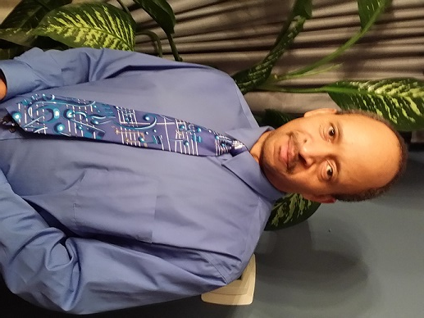
The focal energy of your horoscope is in terms of (Sun sign) and expressed in a personality that needs (Moon sign) and together they are expressed through an image of (Ascendant sign).
Basil Fearrington

Slide 20
Idealism in the Horoscope
Jupiter conjunct, square or opposition Neptune
Neptune with any inner planet, light
Sun conjunct Mercury or Venus
Mercury conjunct or sextile Venus

Slide 21
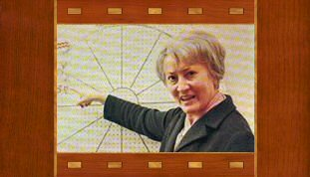
…Such a planet will not be weak or ineffective but, lacking the interchanges with other planets, its principles, and especially its drive or urge as an instinct or a force in the unconscious self, will not be properly integrated into the wholeness of the person.
Unaspected Planets
Margaret Hone

Slide 22
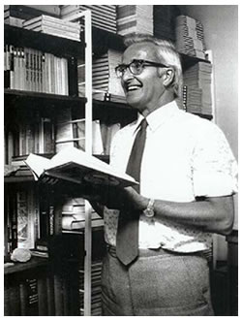
This does not mean the planet is a weak actor in the chart.
Usually it is indicative, according to the planet, sign and house involved, of a feature in the life of the person which it is difficult or perhaps not integrated with the rest of the nature or life-pattern.
Jeff Mayo

Slide 23
From Noel Tyl…Some Points to Consider When Interpreting Unaspected Planets
Unaspected planets do not connect with the rest of the psyche – much like someone in a foreign land, it is disconnected from the surroundings, and integration becomes challenging.
This can be mirrored as a feeling of disconnection in outer relationships, especially if a key body such as the Sun or the Moon is peregrine: there may be a feeling that the world doesn’t quite understand us. We may “march to a different drummer.”
Because smooth integration is difficult, often how we use the energy of the unaspected planet tends to be over-compensatory: Unaspected Mercury could suggest someone whose emphasis on thoughts or speech is pronounced, like the writer Norman Vincent Peale, who wrote “The Power of Positive Thinking.” It could just as well suggest someone that cannot seem to stop talking.
As a result of overcompensation, the unaspected planet may gain dominance within the personality, almost becoming the defining characteristic of the person. How such dominance is expressed of course depends on the “level” of the person.
An unaspected planet may be interpreted as both strong yet insecure, dominant yet vulnerable to isolation. Consider how such dual meaning would color the archetypal expression of the unaspected planet.

Slide 24
Unaspected Sun: Marching to a different drumbeat.
Unaspected Moon: Possibly suggests emotional disconnection from the parents.
Unaspected Mercury: Emphasis on thoughts and/or speech. Gandhi, Marion March
Unaspected Venus: Difficulty relating to others in a relaxed manner.
Unaspected Mars: May need special focus for directing one’s considerable energy.
Unaspected Jupiter: Emphasis on philosophy, education and international or spiritual dimensions.
Unaspected Saturn: Possible lack of support from father figure
Unaspected Uranus: Emphasis on being significant, or being different from others.
Unaspected Neptune and Pluto are rare today, due to their 60+ year sextile.

Slide 25
Resources:
Fearrington, Basil. The New Way to Learn Astrology. (St. Paul, MN: Llewellyn Publications, 1999)
Idemon, Richard, Through the Looking Glass: A Search for Self in the Mirror of Relationships (York Beach, ME: Samuel Weiser, Inc., 1992), Part One.
Sasportas, Howard, The Twelve Houses: An Introduction to the Houses in Astrological Interpretation (Wellingborough: Aquarian Press, 1985), 'Chapter 15.
http://www.astro.com/mtp/mtpt13_e.htm, accessed 10/27/14
http://johnsandbach.com/?p=227, accessed 10/27/14
http://www.themetaarts.com/2005june/basilfearington.html, accessed 10/27/14
http://www.yogicastrology.com/articles/western-astrology/hemispheres_quadrants_angles.shtml, accessed 10/27/14
https://groups.google.com/forum/#!topic/opentarotnexus/-GYTLO9F9uE, accessed 10/27/14

